Slide 1
Faculty Academic Advising System Faculty of Engineering, HKU

Slide 2
Academic Advising
What do I want to do after graduation?
I want to talk to someone about my study….
Where can I find relevant information?

Slide 3
Faculty Academic Advising System
Academic Advising & First Year Experience Faculty Coordinator
First Year Adviser
Faculty Academic Adviser
Temporary Academic Adviser
Peer Mentor

Slide 4
Faculty Academic Advising System
First Year Adviser (FYA)
Each new student will be assigned an Academic Adviser in the Faculty of Engineering called First Year Adviser (FYA)
The FYA will offer advice and guidance to students on academic matters such as course enrollment, programme selection, career plans, etc. in their first year of studies
You are highly encouraged to consult your FYA’s advice before course enrollment period, and at least once per every semester during your first year of studies

Slide 5
Sign-up System for First Year Adviser
How to sign up?
You will be invited to select directly from the list of advisers on a first-come-first-served basis
Sign-up for your FYA from 2:00pm, August 14, 2023 (Monday) to 10:00am, August 21, 2023 (Monday) at https://ugaa.hku.hk/signup-faa.php
If you do not sign up by August 21, 2023, the System will randomly assign one to you
There is another round of sign-up for your First Year Adviser if you are late-comers, from 10:00am, August 22, 2023 (Tuesday) to 4:00pm, August 28, 2023 (Monday)
If you do not sign up by August 30, 2023, the System will randomly assign one to you
For details, please refer to the email from Faculty Office

Slide 6
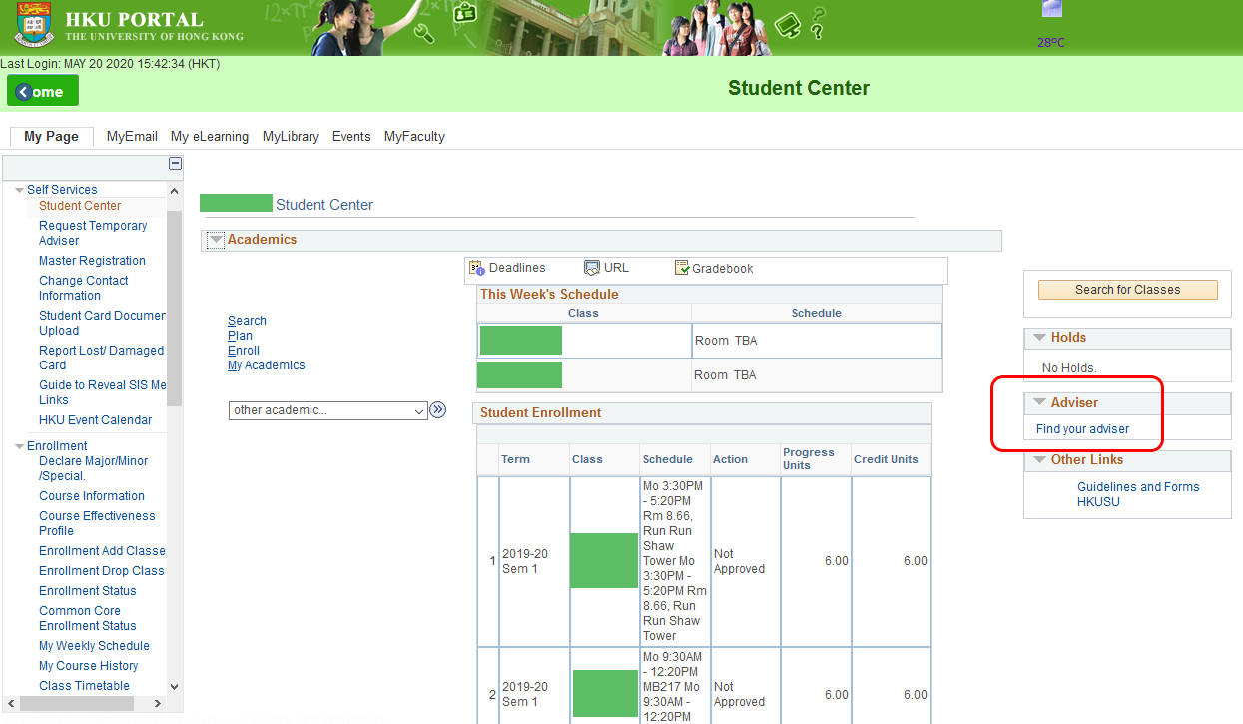
Sign-up System for First Year Adviser
How to find your FYA from the Student Information System (SIS)?
Login to HKU Portal
On “My Page”, click “Find your adviser” on the right-hand side (see the screen capture below)

Slide 7
Faculty Academic Advising System
Faculty Academic Adviser (FAA)
Students will be assigned an Academic Adviser from their Home Department after they have selected their study programme in the beginning of their second year of studies, who will provide programme-specific academic advice and career planning

Slide 8
Faculty Academic Advising System
Peer Mentor
Each new student will be assigned a Faculty Student Adviser (FSA) in the Faculty of Engineering called Peer Mentor (a senior year student) to help first year students in adjusting to the university studying and living environment

Slide 9
Sign-up System for Peer Mentor
How to sign up? (Same as the Sign-up system for First Year Adviser)
You will be invited to select directly from the list of Peer Mentors on a first-come-first-served basis
Sign-up for your Peer Mentor from 2:00pm, August 14, 2023 (Monday) to 10:00am, August 21, 2023 (Monday) at https://ugaa.hku.hk/signup-faa.php
If you do not sign up by August 21, 2023, the System will randomly assign one to you
There is another round of sign-up for your Peer Mentor if you are late-comers, from 10:00am, August 22, 2023 (Tuesday) to 4:00pm, August 28, 2023 (Monday)
If you do not sign up by August 30, 2023, the System will randomly assign one to you
For details, please refer to the email from Faculty Office

